Slide 1


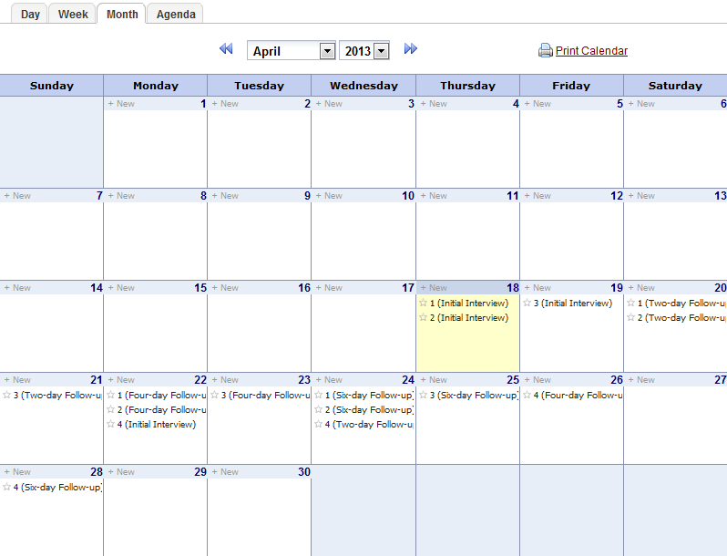
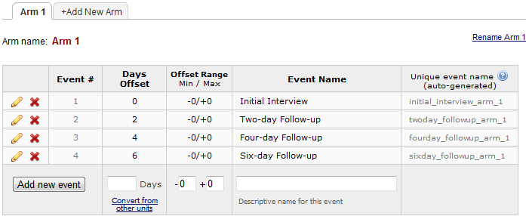
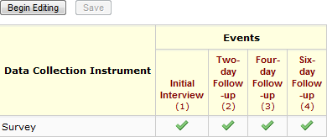
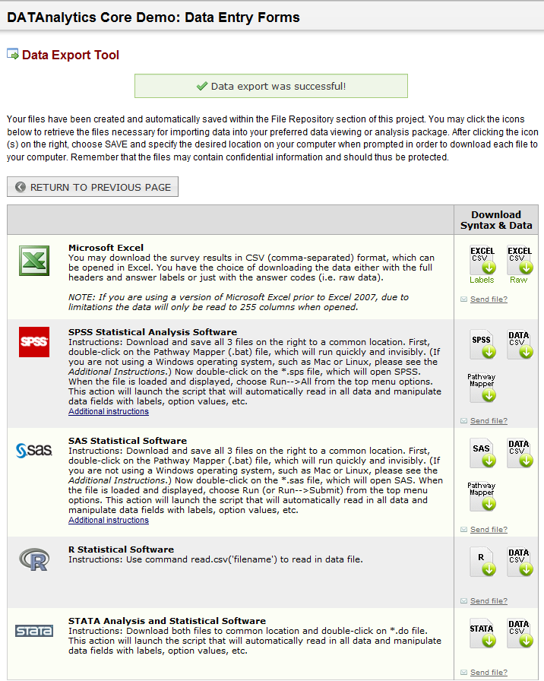
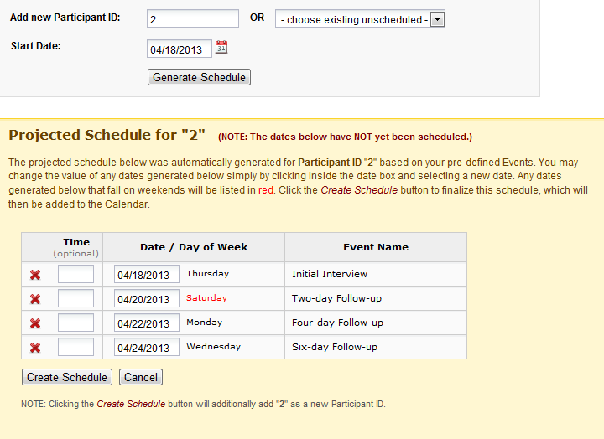
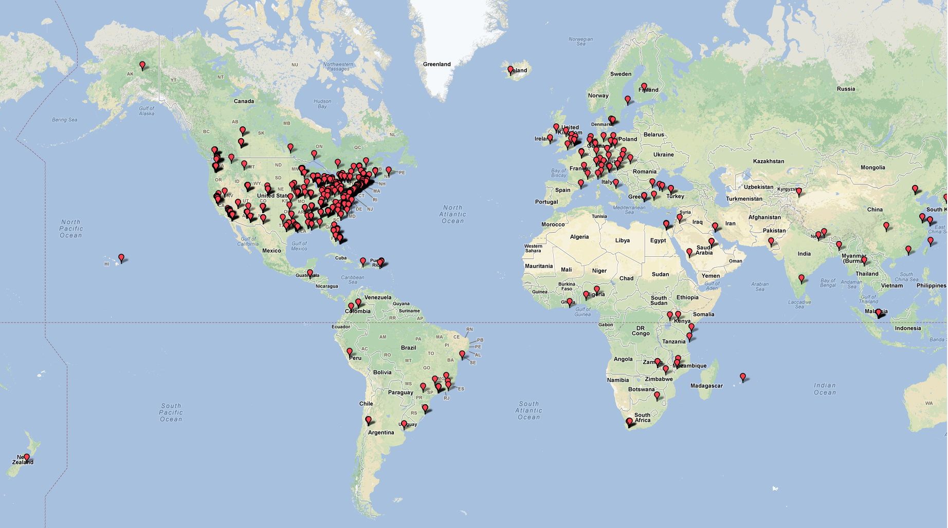
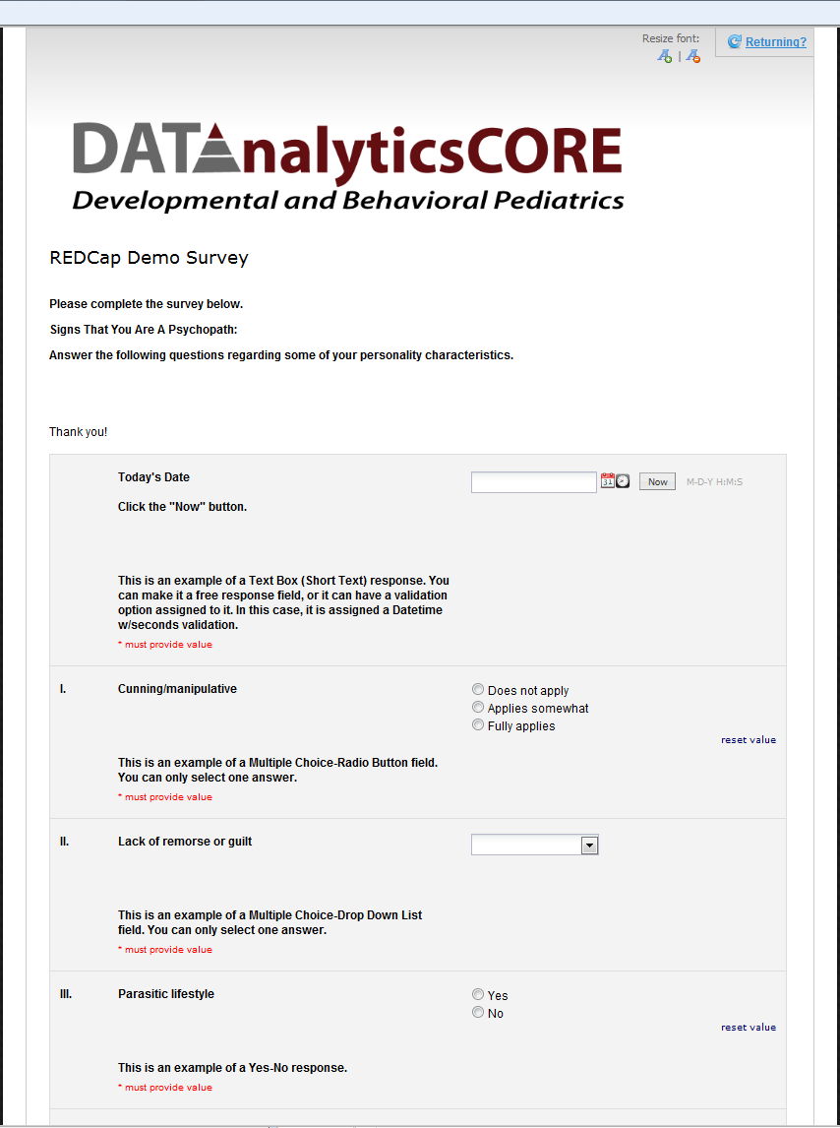
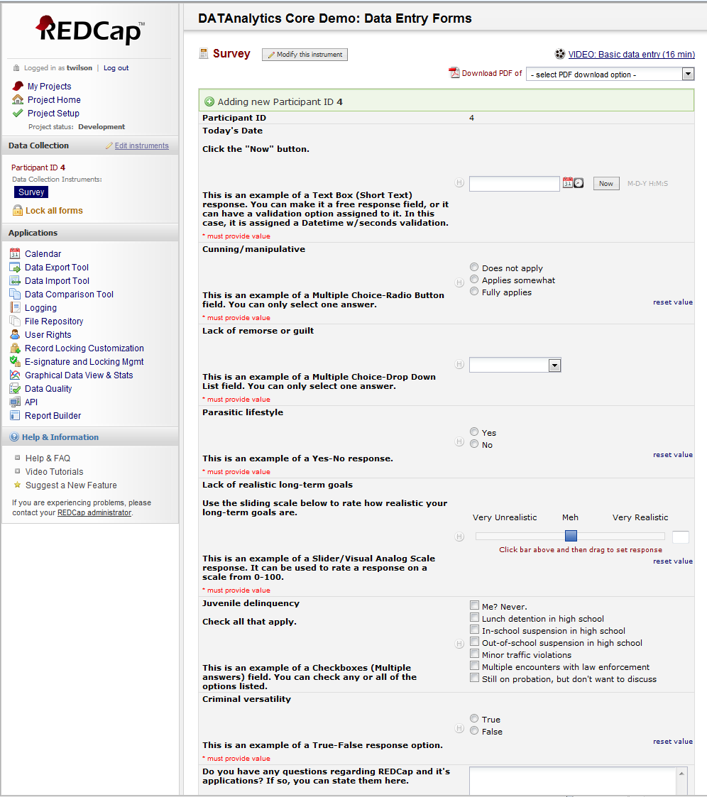

REDCap
Research Electronic Data Capture
Thomas Wilson, David E. Bard, and William H. Beasley,
OUHSC, Developmental and Behavioral Pediatrics
If you have questions, or would like assistance applying this system (or a subset of its tools) to current or future projects, please contact: william-beasley@ouhsc.edu, thomas-wilson@ouhsc.edu, or david-bard@ouhsc.edu.
What is REDCap?
Support Features
Featured Software Highlights
A no cost, secure web application for building and managing online surveys and databases
Designed for academic biomedical researchers
Concurrent and distributed data entry allowing multiple simultaneous users
Dynamic Content
3 Types of projects
Single Survey
Data Entry Forms
Single Survey + Data Entry Forms
Multi-site accessibility
Customizable
REDCap consortium composed of 612 active institutional partners in 55 countries
http://project-redcap.org/
User-group network
Example templates
Instructional training videos
Built-in project Calendar
Scheduling Module
(Define Events)
Scenarios Favoring REDCap
Project requires centralized data storage, but multiple locations for data entry
A flexible, universal framework to create consistent data systems
Project has a relatively flat data structure
Typically accommodates 2 or 3 levels well.
No professional software developer is necessary
Accommodates the designs and needs for multiple types of clinical projects
(Assign Instrument)
Built-in export formats
(Schedule Participant)
Single Survey Project
Data Entry Forms
Utilize an online survey for data collection
Can be e-mailed to participants
Public survey
Private Survey
Survey can be completed in a clinical setting
“Save and Return” option
Customizable logo and headings
Utilize an online method of data collection
Well-suited for clinical settings
Can be used in longitudinal studies
Supports limited html tags
“Save and Return” option
Calendar and Scheduling Module

